Slide 1
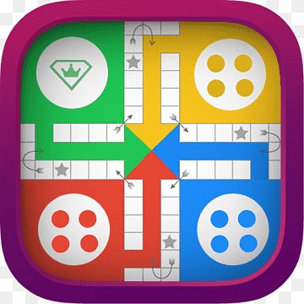
Mini Ludo
Ludo is a classic board game that has been implemented in this program. The objective is to move your piece around the board and get them to the center of the board before your opponents do. The program consists of several functions and structures, as well as a main function that orchestrates the game.

Slide 2
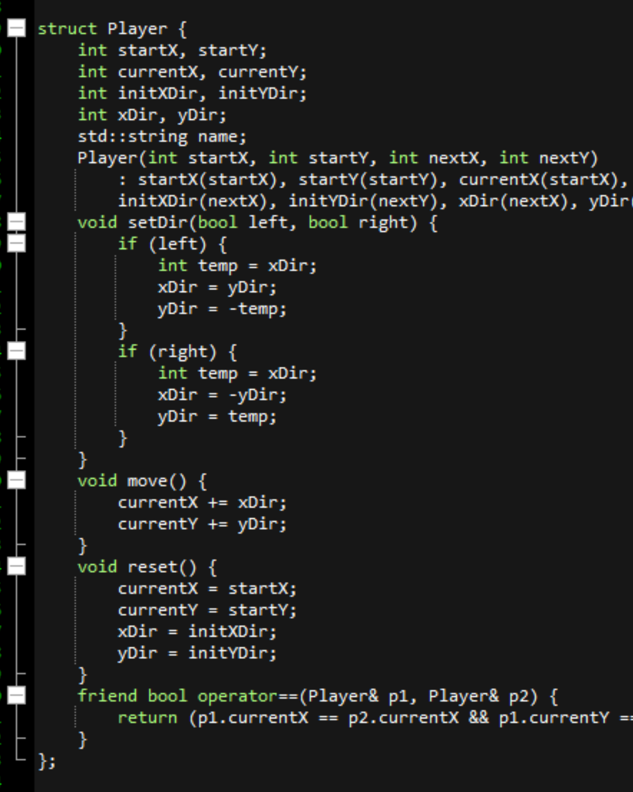
Player Structure
The Player structure holds the current and initial positions of the player's pieces, as well as their direction and name. It has functions for setting the direction of the piece, moving it, and resetting it.

Slide 3
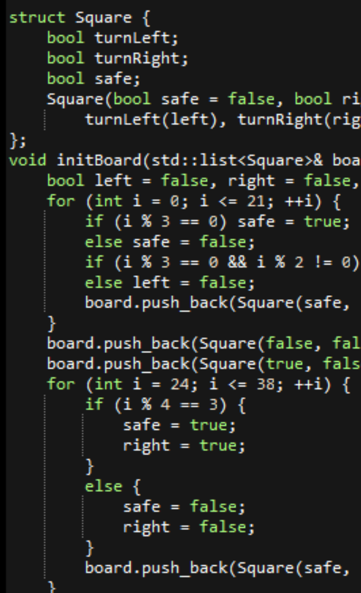
Square Structure
The Square structure holds information about each square on the board, such as whether it is a safe square or whether it requires the player to turn left or right.
initBoard Function
The initBoard function initializes the board with the correct sequence of squares and their attributes. It populates a list of Square structures that represents the game board.

Slide 4
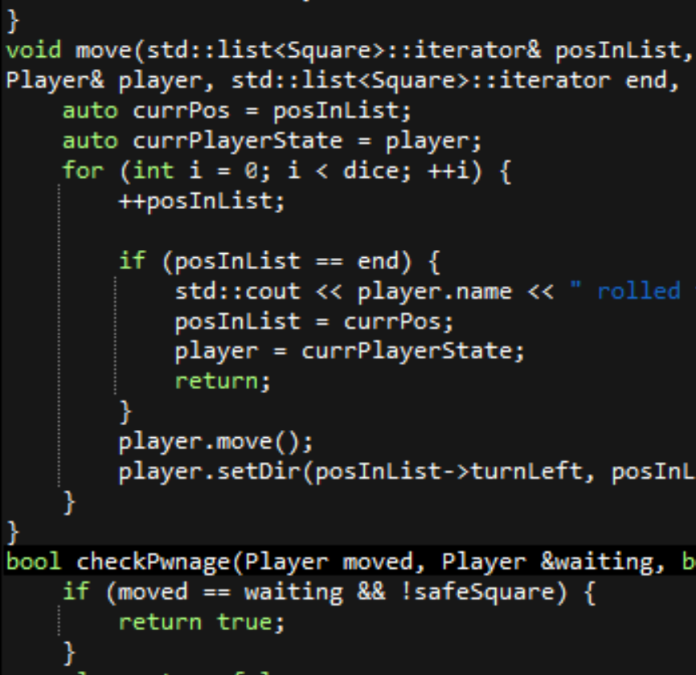
Move Function
The move function moves the player's piece a given number of spaces, updating the player's direction and checking for collisions with other players. It takes an iterator to the player's current position in the list of Squares, and moves the player to the next position, updating their direction along the way.

Slide 5
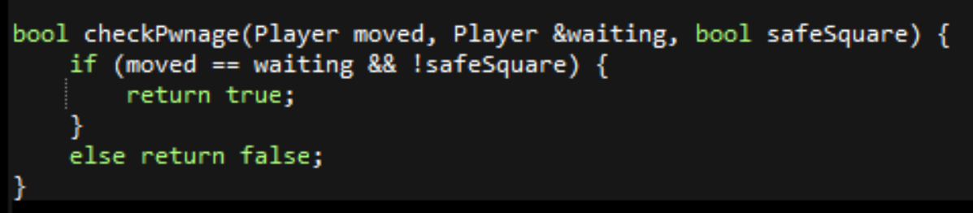
Check for collision (checkPwnage)
The checkPwnage function checks whether the player has collided with another player and sends the other player back to the starting position. If a player lands on the same square as another player and that square is not marked as safe, the other player is sent back to the starting position.

Slide 6
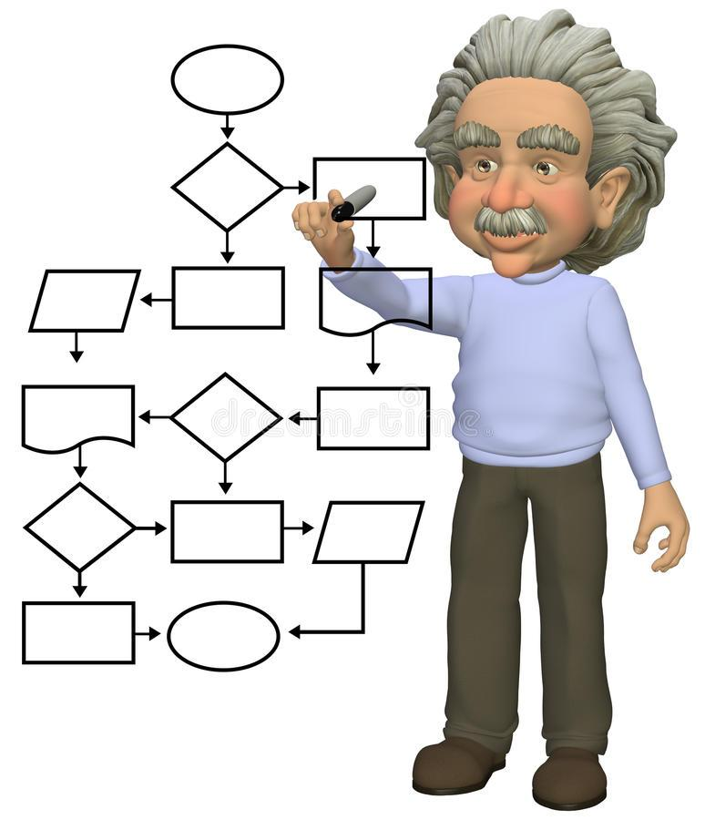
Program flow
The code enters a while loop that runs as long as "letsPlay" is true.
Inside the while loop, it initializes each player's position and direction, prints the board, and sets the number of winners to zero. The code enters a do-while loop that runs as long as the number of winners is less than four.
Inside the do-while loop, it rolls a die for the current player, moves the player's piece accordingly, checks for collisions with other players and sends them back to their starting positions if necessary, and checks if the current player has won the game.

Slide 7

This implementation of the Ludo board game provides a fun and interactive way for players to enjoy the classic game in a digital format.

